Slide 1
MODULE-3
Chapter- 6 Application Protocols for IoT

Slide 2
Application Protocols for IoT
IoT application protocols you select should be contingent on the use cases and vertical industries they apply to
IoT application protocols are dependent on the characteristics of the lower layers themselves
For example, application protocols that are sufficient for generic nodes and traditional networks often are not well suited for constrained nodes and networks
This chapter focuses on how higher-layer IoT protocols are transported
The Transport Layer: IP-based networks use either TCP or UDP. However, the constrained nature of IoT networks requires a closer look at the use of these traditional transport mechanisms.
IoT Application Transport Methods: This section explores the various types of IoT application data and the ways this data can be carried across a network.

Slide 3
The Transport Layer
The transport layer as supported by the TCP/IP architecture in the context of IoT networks. With the TCP/IP protocol, two main protocols are specified for the transport layer
Transmission Control Protocol (TCP): This connection-oriented protocol requires a session to get established between the source and destination before exchanging data.
User Datagram Protocol (UDP):
connectionless protocol, data can be
With quickly
this sent
between source and destination—but with no guarantee of delivery. This is analogous to the traditional mail delivery system

Slide 4
With the predominance of human interactions over the Internet, TCP is the main protocol used at the transport layer.
This is largely due to its inherent characteristics, such as its ability to transport large volumes of data into smaller sets of packets.
In addition, it ensures reassembly in a correct sequence, flow control and window adjustment, and retransmission of lost packets
UDP is most often used in the context of network services, such as Domain Name System (DNS), Network Time Protocol (NTP), Simple Network Management Protocol (SNMP), and Dynamic Host Control Protocol (DHCP), or for real-time data traffic, including voice and video over IP.

Slide 5
IoT Application Transport Methods
Because of the diverse types of IoT application protocols, there are various means for transporting these protocols across a network
The following categories of IoT application protocols and their transport methods are explored in the following sections:
Application layer protocol not present: In this case, the data payload is directly transported on top of the lower layers. No application layer protocol is used.
Supervisory control and data acquisition (SCADA): SCADA (real time) is one of the most common Industrial protocols in the world, but it were developed long before the days of IP, and it has been adapted for IP networks.

Slide 6
Generic web-based protocols: Generic protocols, such as Ethernet, Wi-Fi, and 4G/LTE, are found on many consumer- and enterprise-class IoT devices that communicate over non-constrained networks
IoT application layer protocols: IoT application layer protocols are devised to run on constrained nodes with a small compute footprint and are well adapted the network bandwidth constraints on cellular or satellite links or constrained 6LoWPAN networks.
Message Queuing Telemetry Transport (MQTT) (transmit and receive data over a resource-constrained network with limited bandwidth.) and Constrained Application Protocol (CoAP), constrained devices to join the IoT even through constrained networks with low bandwidth and low availability.

Slide 7
Application Layer Protocol Not Present
IETF RFC 7228 devices defined as class 0 send or receive only a few bytes of data. reasons, such as processing capability, power constraints, and cost, these devices do not implement a fully structured network protocol stack, such as IP, TCP, or UDP, or even an application layer protocol.
Class 0 devices are usually simple smart objects that are severely constrained Implementing a robust protocol stack is usually not useful and sometimes not even possible with the limited available resources.
For example, consider low-cost temperature and relative humidity (RH) sensors sending data over an LPWA LoRaWAN infrastructure
Temperature is represented as 2 bytes and RH as another
2 bytes of data. Therefore, this small data payload is directly transported on top of the LoRaWAN MAC layer, without the use of TCP/IP.

Slide 8
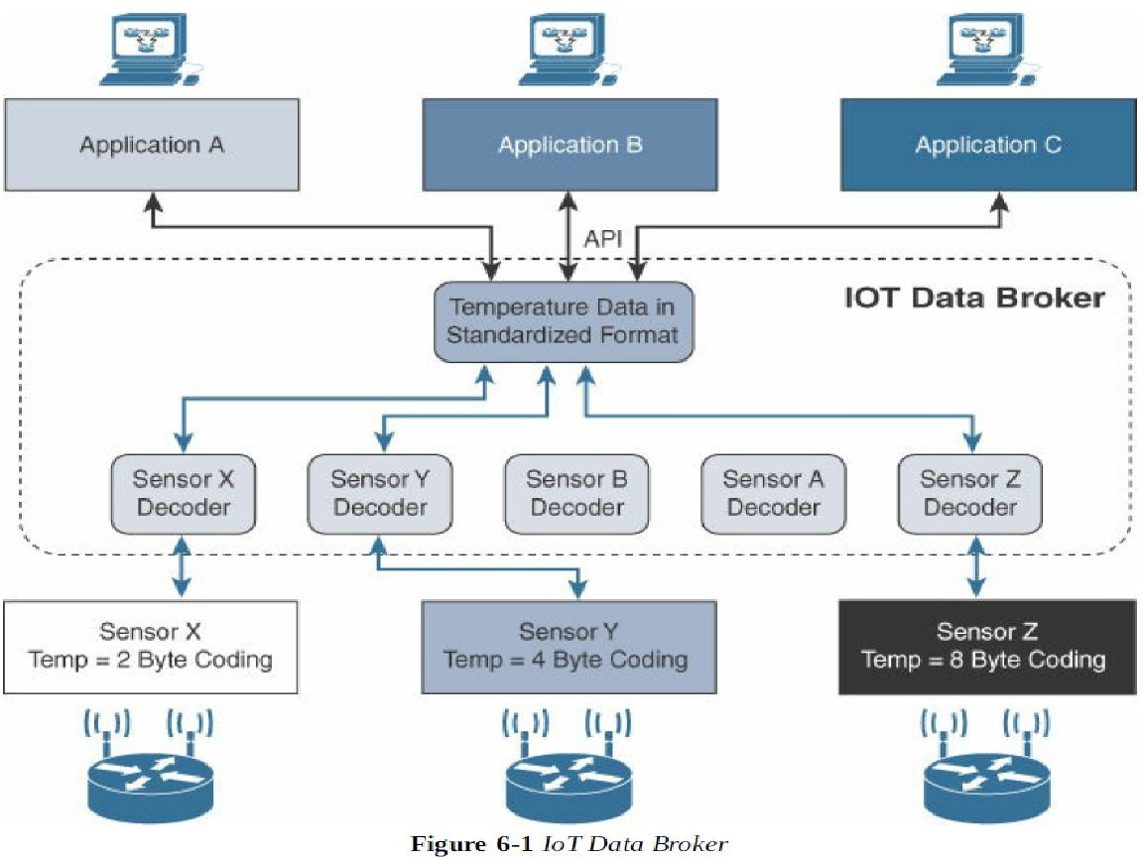

Slide 9
SCADA (supervisory control and data acquisition)
In the world of networking technologies and protocols, IoT is relatively new. Combined with the fact that IP is the de facto standard for computer networking in general,
Older protocols that connected sensors and actuators have evolved and adapted themselves to utilize IP.
A prime example of this evolution is supervisory control and data acquisition (SCADA).
Designed decades ago, SCADA is an automation control system that was initially implemented without IP over serial links, before being adapted to Ethernet and IPv4

Slide 10
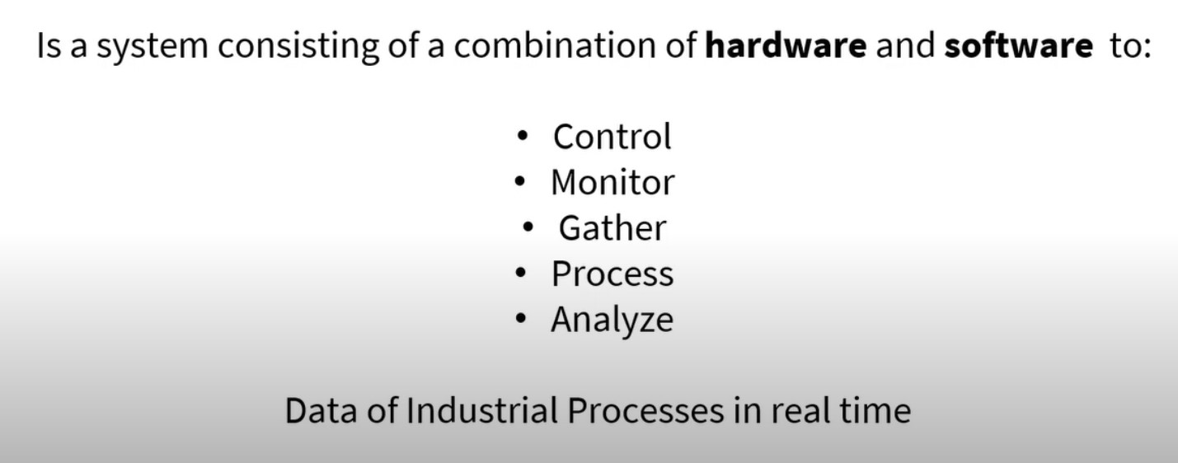

Slide 11
Adapting SCADA for IP
Legacy serial protocols have adapted and evolved to utilize IP and TCP/UDP as both networking and transport mechanisms
The IEEE 1815-2012 specification describes how the DNP3(Distributed Network Protocol3) protocol implementation must be adapted to run either over TCP (recommended) or UDP.
DNP3 is based on a master/slave relationship.
Master: a powerful computer located in the control centre of a utility.
Slave: a remote device with computing resources found in a location such as substation.
DNP3 typically referred as outstations.

Slide 12
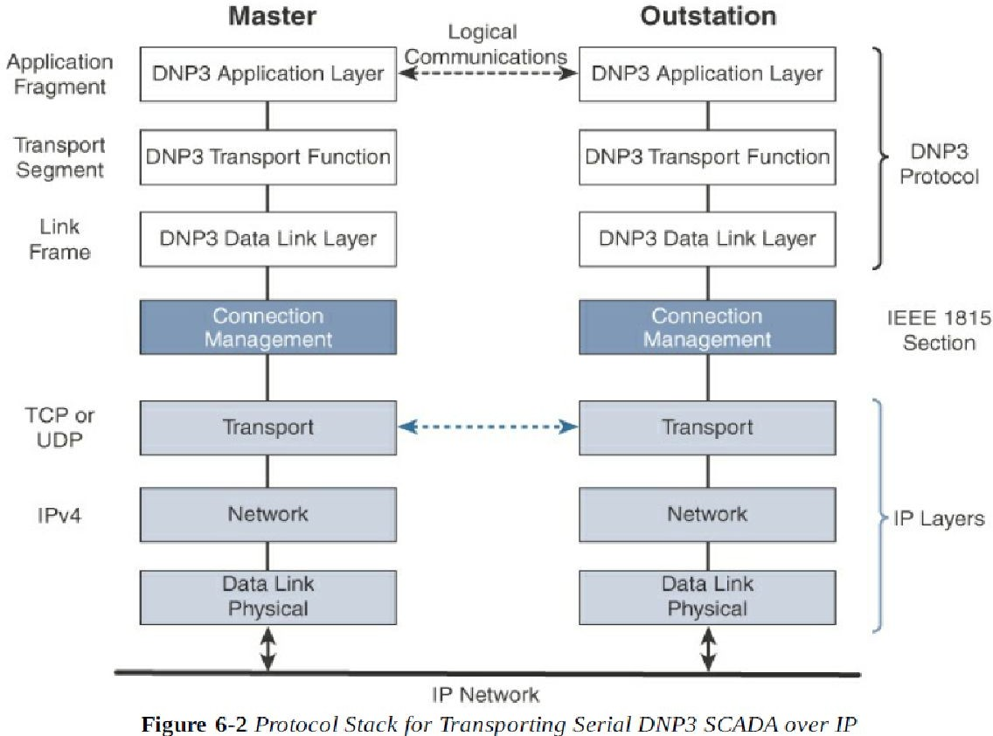

Slide 13
The master side initiates connections by performing a TCP active open
The outstation listens for a connection request by performing a TCP passive open
Dual endpoint is defined as a process that can both listen for connection requests and perform an active open on the channel if required
Master stations may parse multiple DNP3 data link layer frames from a single UDP datagram, while DNP3 data link layer frames cannot span multiple UDP datagram’s
Single or multiple connections to the master may get established while a TCP keep alive timer monitors the status of the connection

Slide 14
SCADA Protocol Translation
An alternative to a raw socket connection for transporting legacy serial data across an IP network is protocol translation
With protocol translation, the legacy serial protocol is translated to corresponding IP version
For example, Figure 6-4 shows two serially connected DNP3 RTUs and two master applications supporting DNP3 over IP that control and pull data from the RTUs
The IoT gateway in this figure performs a protocol translation function that enables communication between the RTUs and servers
RTU: a multi purpose device used to monitor and control various systems, application and devices managing automation

Slide 15
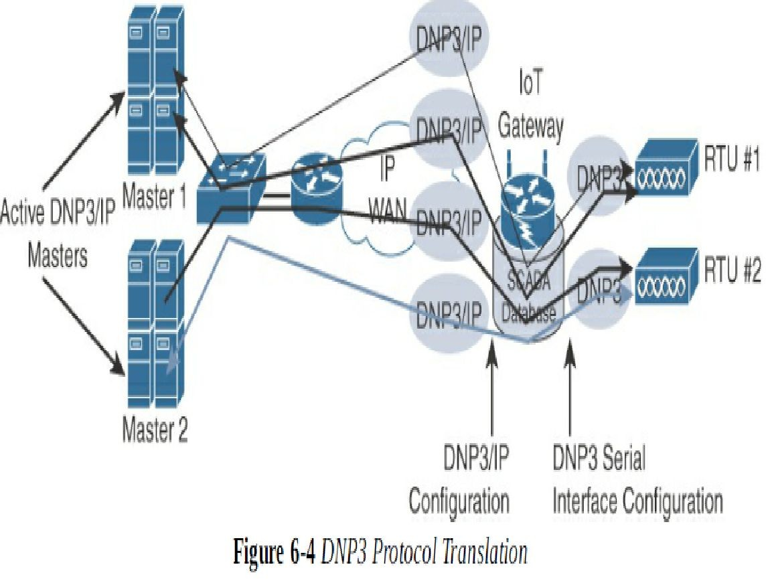

Slide 16
IoT Application Layer Protocols
When considering constrained networks and/or a large-scale deployment of constrained nodes, verbose web-based and data model protocols, may be too heavy for IoT applications.
To address this problem, the IoT industry is working on new lightweight protocols that are better suited to large numbers of constrained nodes and networks. Two of the most popular protocols are CoAP and MQTT
CoAP and MQTT are naturally at the top of this sample IoT stack, based on an IEEE 802.15.4 mesh network. While there are a few exceptions, you will almost always find CoAP deployed over UDP and MQTT running over TCP

Slide 17
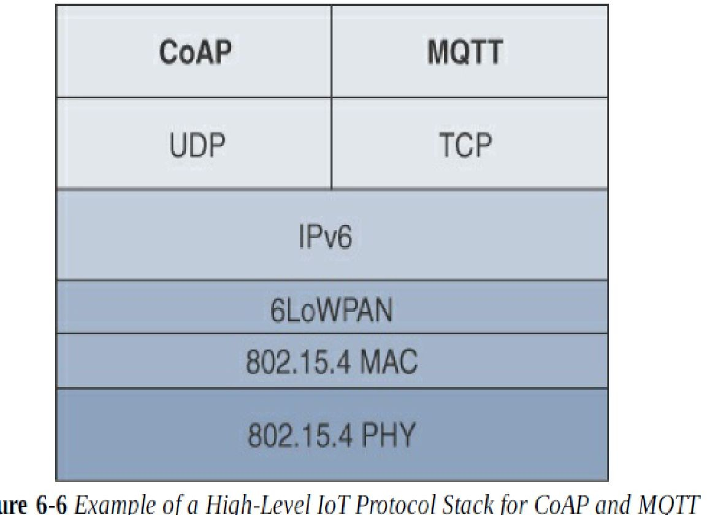

Slide 18
CoAP (Constrained Application Protocol)
The IETF Constrained RESTful Environments (CoRE) working group’s efforts to develop a generic framework for resource-oriented applications targeting constrained nodes and networks
The CoAP framework defines simple and flexible ways to manipulate sensors and actuators for data or device management.
The CoAP messaging model is primarily designed to facilitate the exchange of messages over UDP between endpoints, including the secure transport protocol Datagram Transport Layer Security (DTLS).
CoAP message is composed of a short fixed-length Header field (4 bytes), a variable-length but mandatory Token field (0–8 bytes), Options fields if necessary, and the Payload

Slide 19
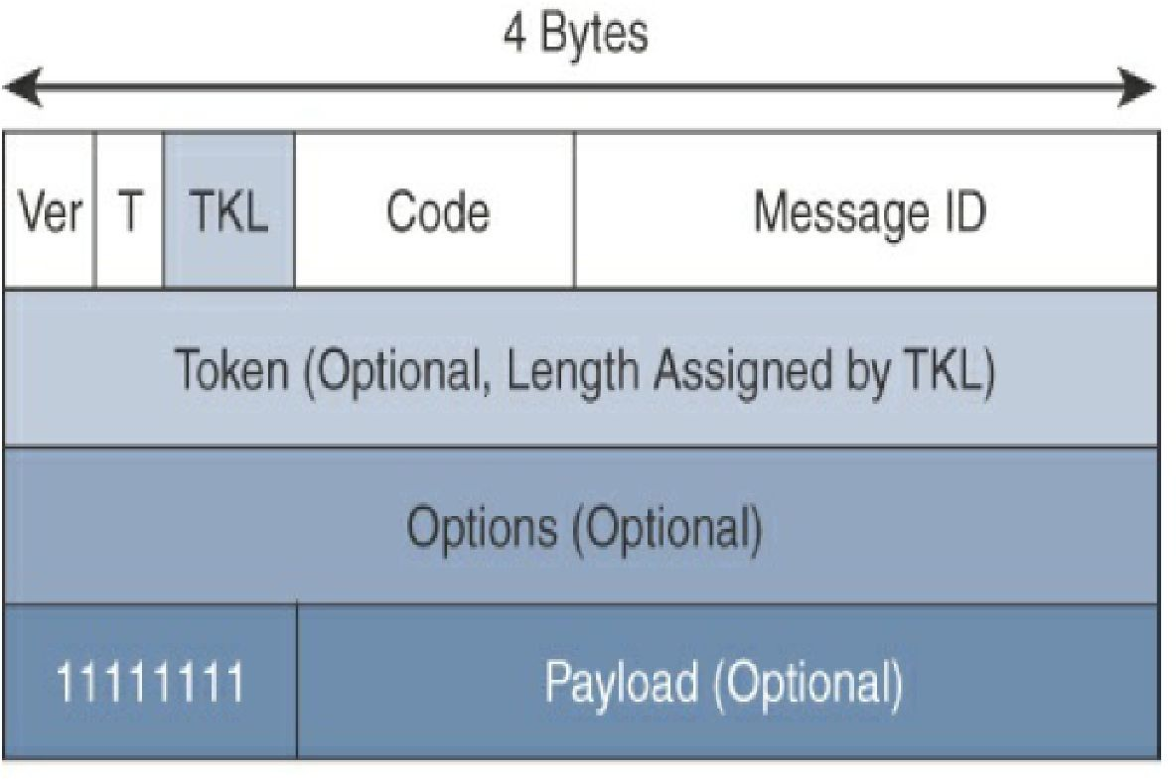
Figure 6-7 CoAP Message Format

Slide 20
As you can see in Figure 6-7, the CoAP message format is relatively simple and flexible.
It allows CoAP to deliver low overhead, which is critical for constrained networks, while also being easy to parse and process for constrained devices.
Table 6-1 provides an overview of the various fields of a CoAP message
CoAP can run over IPv4 or IPv6. However, it is recommended that the message fit within a single IP packet and UDP payload to avoid fragmentation.
For IPv6, with the default MTU size being 1280 bytes and allowing for no fragmentation across nodes, the maximum CoAP message size could be up to 1152 bytes, including 1024 bytes for the payload

Slide 21
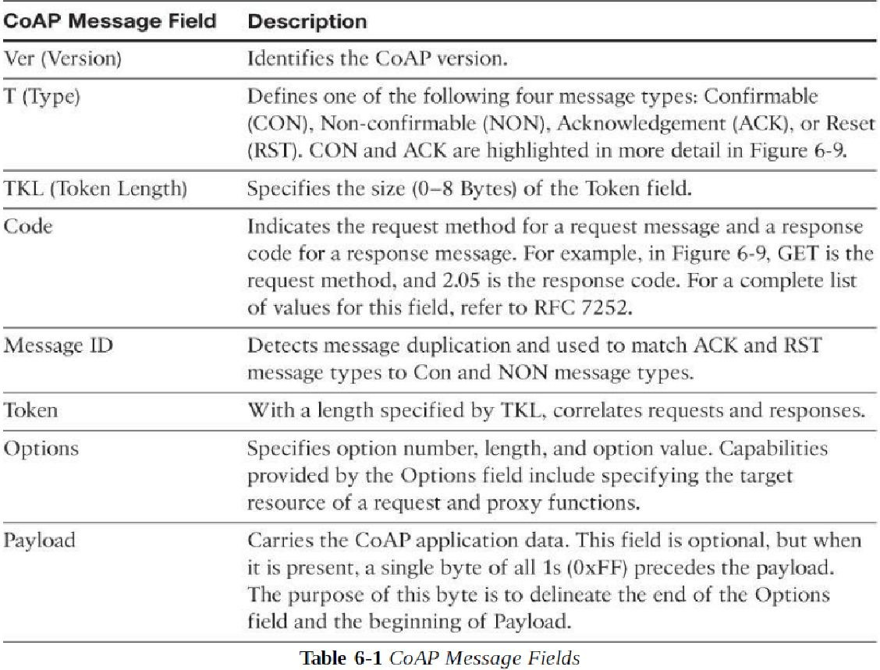

Slide 22
CoAP communications across an IoT infrastructure can take various paths. Connections can be between devices located on the same or different constrained networks or between devices and generic Internet or cloud servers, all operating over IP
Proxy mechanisms are also defined, and RFC 7252 details a basic HTTP mapping for CoAP. As both HTTP and CoAP are IP-based protocols, the proxy function can be located practically anywhere in the network, not necessarily at the border between constrained and non-constrained networks.
Just like HTTP, CoAP is based on the REST architecture, but with a “thing” acting as both the client and the server. Through the exchange of asynchronous messages, a client requests an action via a method code on a server resource

Slide 23
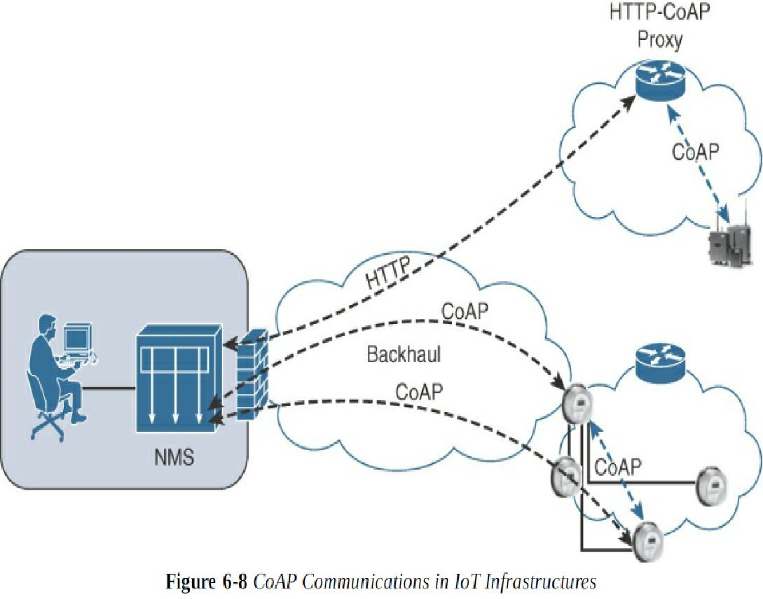

Slide 24
A uniform resource identifier (URI) localized on the server identifies this resource.
The server responds with a response code that may include a resource representation.
The CoAP request/response semantics include the methods GET, POST, PUT, and DELETE. Example 6-2 shows the CoAP URI format.
You may notice that the CoAP URI format is similar to HTTP/HTTPS. The coap/coaps URI scheme identifies a resource, including host information and optional UDP port, as indicated by the host and port parameters in the URI
coaps-URI = "coaps:" "//" host [":" port] path-abempty ["?" query]

Slide 25
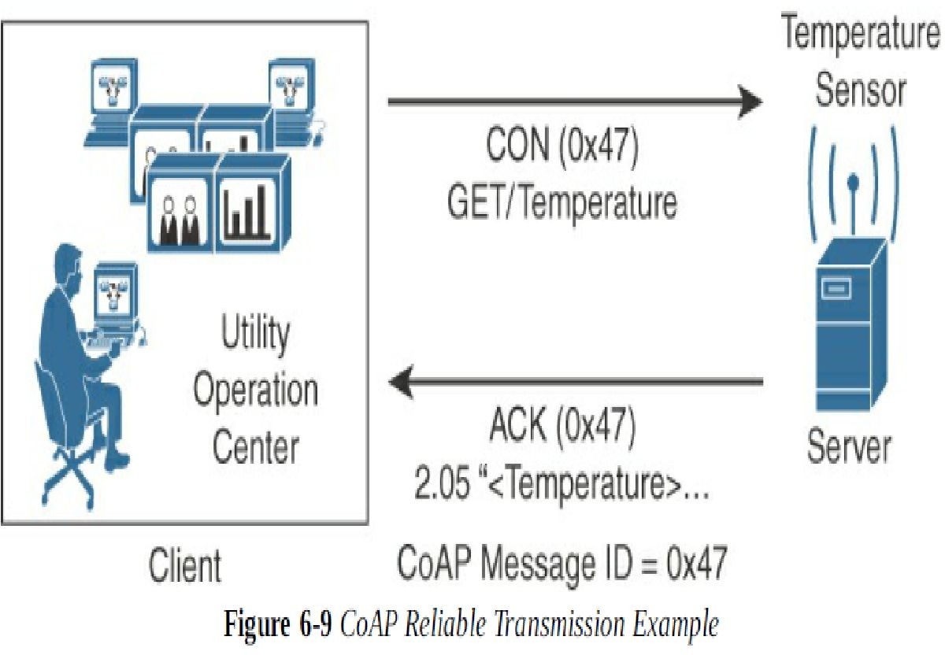

Slide 26
The client in Figure 6-9 sends a GET message to get the temperature from the sensor.
Notice that the 0x47 message ID is present for this GET message and that the message is also marked with CON. A CON, or confirmable, marking in a CoAP message means the message will be retransmitted until the recipient sends an acknowledgement (or ACK) with the same message ID.
In Figure 6-9, the temperature sensor does reply with an ACK message referencing the correct message ID of 0x47.
In addition, this ACK message piggybacks a successful response to the GET request itself. This is indicated by the 2.05 response code followed by the requested data

Slide 27
Message Queuing Telemetry Transport (MQTT)
At the end of the 1990s, engineers from IBM and Arcom were looking for a reliable, lightweight, and cost-effective protocol to monitor and control a large number of sensors and their data from a central server location
As typically used by the oil and gas industries. Their research resulted in the development and implementation of the Message Queuing Telemetry Transport (MQTT) protocol that is now standardized by the Organization for the Advancement of Structured Information Standards (OASIS).
These were some of the rationales for the selection of a client/server and publish/subscribe framework based on the TCP/IP architecture, as shown in Figure 6-10.

Slide 28
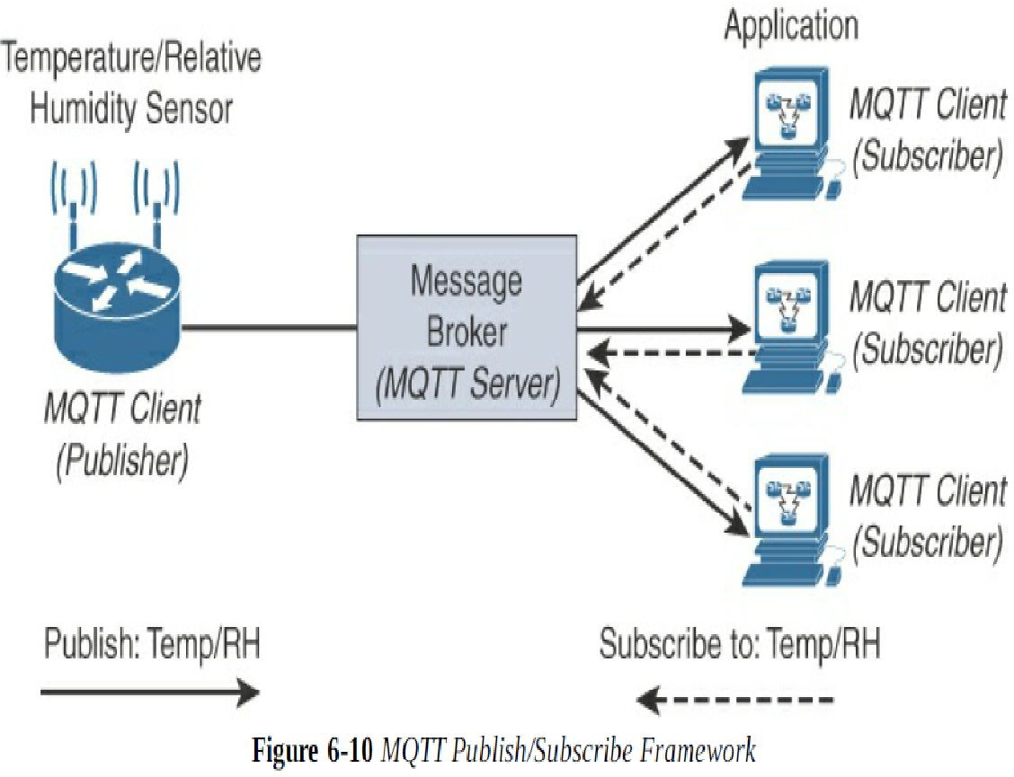

Slide 29
An MQTT client can act as a publisher to send data (or resource information) to an MQTT server acting as an MQTT message broker.
In the example illustrated in Figure 6-10, the MQTT client on the left side is a temperature (Temp) and relative humidity (RH) sensor that publishes its Temp/RH data.
The MQTT server (or message broker) accepts the network connection along with application messages, such as Temp/RH data, from the publishers.
It also handles the subscription and un-subscription process and pushes the application data to MQTT clients acting as subscribers.
This model, where subscribers express a desire to receive information from publishers, is well known. A great example is the collaboration and social networking application Twitter.

Slide 30
MQTT is a lightweight protocol because each control packet consists of a 2-byte fixed header with optional variable header fields and optional payload
You should note that a control packet can contain a payload up to 256 MB. Figure 6-11 provides an overview of the MQTT message format
Compared to the CoAP message format in Figure 6-7, you can see that MQTT contains a smaller header of 2 bytes compared to 4 bytes for CoAP.
The first MQTT field in the header is Message Type, which identifies the kind of MQTT packet within a message. Fourteen different types of control packets are specified in MQTT version 3.1.1.
Each of them has a unique value that is coded into the Message Type field. Note that values 0 and 15 are reserved

Slide 31
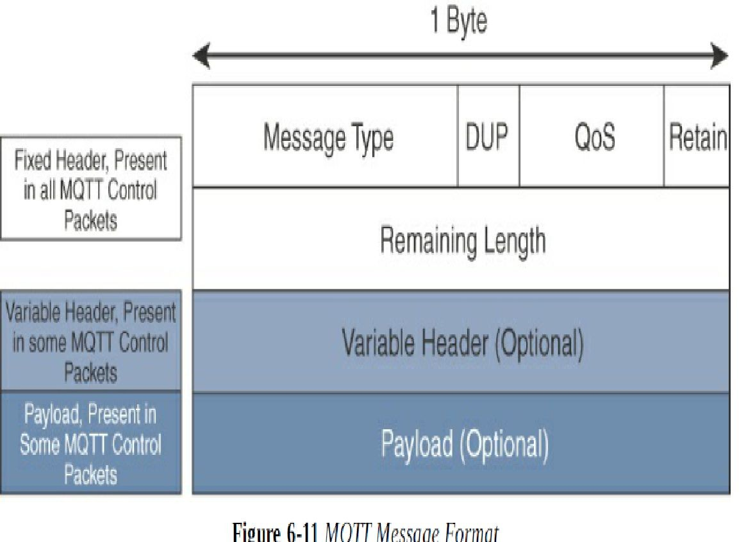

Slide 32
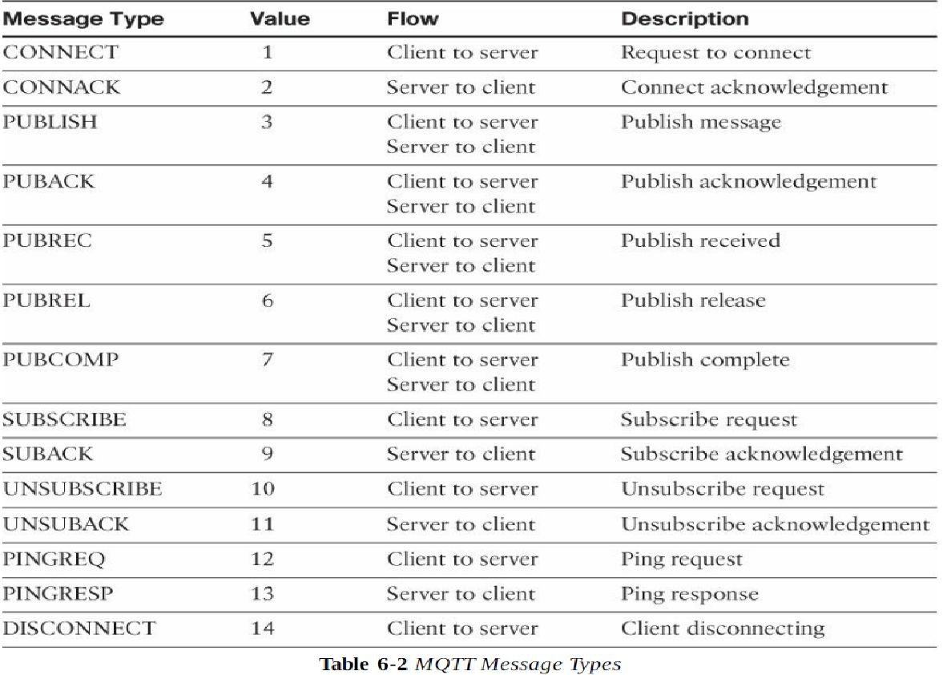
MQTT message types are summarized in Table 6-2.

Slide 33
As mentioned earlier, the QoS process is symmetric in regard to the roles of sender and receiver, but two separate transactions exist.
One transaction occurs between the publishing client and the MQTT server, and the other transaction happens between the MQTT server and the subscribing client.
Figure 6-13 provides an overview of the MQTT QoS flows for the three different levels
The client on each side of the MQTT flow sets the QoS level. The publishing client side sets the QoS level for communications to the MQTT server.
On the other side, the client subscriber sets the QoS level through the subscription with the MQTT server.
As illustrated in Figure 6-13, in most cases, QoS remains the same between clients and broker end to end.
However, you should be aware that in some scenarios, QoS levels change and are not the same end to end.

Slide 34
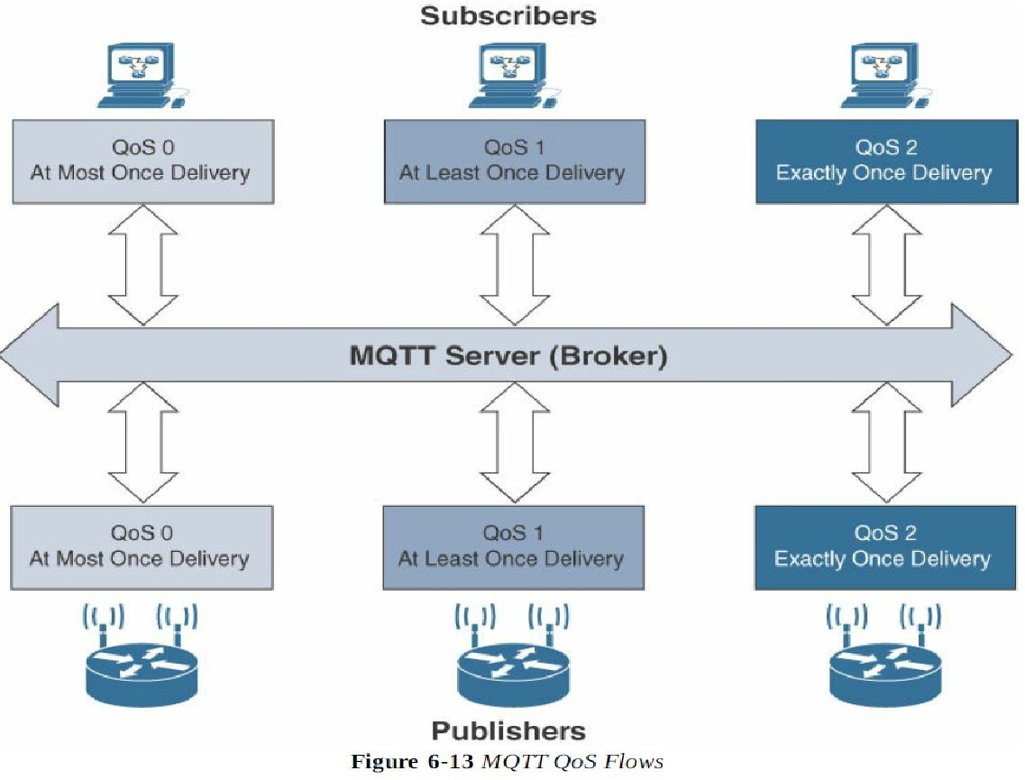

Slide 35
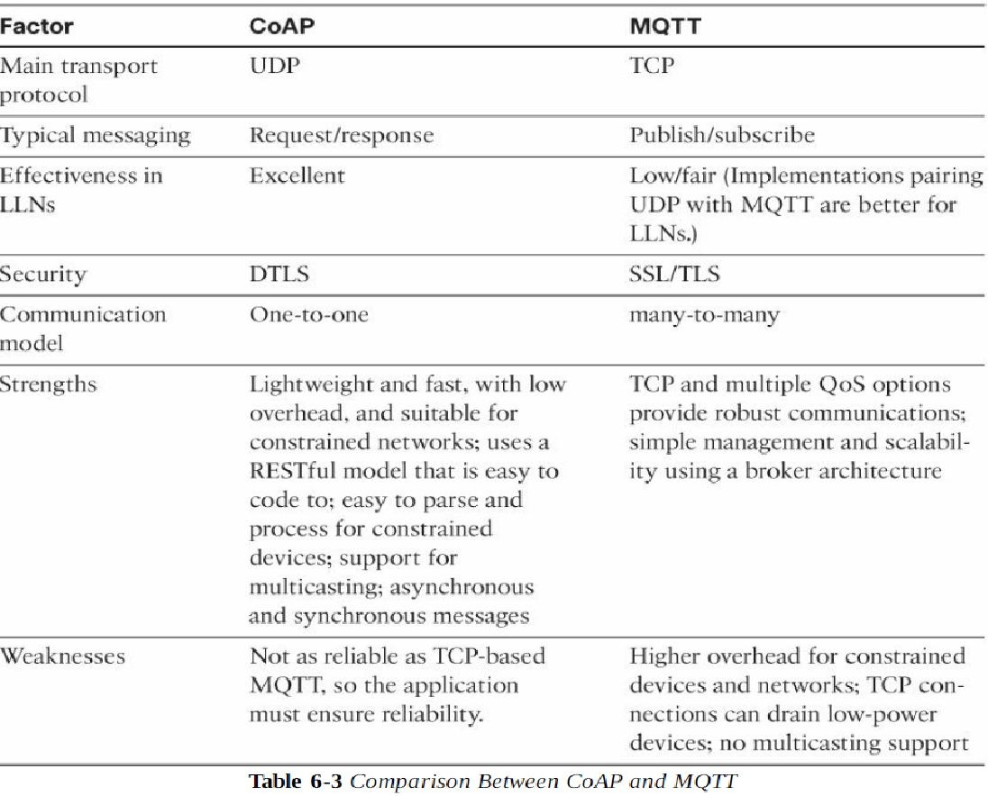

Slide 36
In summary, MQTT is different from the “one-to-one” CoAP model in its “many-to-many” subscription framework, which can make it a better option for some deployments.
MQTT is TCP-based, and it ensures an ordered and lossless connection.
It has a low overhead when optionally paired with UDP and flexible message format, supports TLS for security, and provides for three levels of QoS.
This makes MQTT a key application layer protocol for the successful adoption and growth of the Internet of Things.

